Slide 1
Overview
Module introduction
Ethics in the information age
Code of ethics

Slide 2
INF1007 ETHICS AND PROFESSIONAL CONDUCTS
Trimester 3, AY2022-2023

Slide 3
Teaching Staff
Lecture: Wendy HUI (wendy.hui@singaporetech.edu.sg)
Workshops:
T1: Francis Mahendran
T2: Francis Mahendran
T3: WONG Hong Wai + Cecilia Nathen
T4: WONG Hong Wai + Cecilia Nathen
T5: Wendy HUI
T6: LEE Boon Kheng (Joyce) + LAM Haw Ju Eric
T7: LEE Boon Kheng (Joyce) + LAM Haw Ju Eric

Slide 4
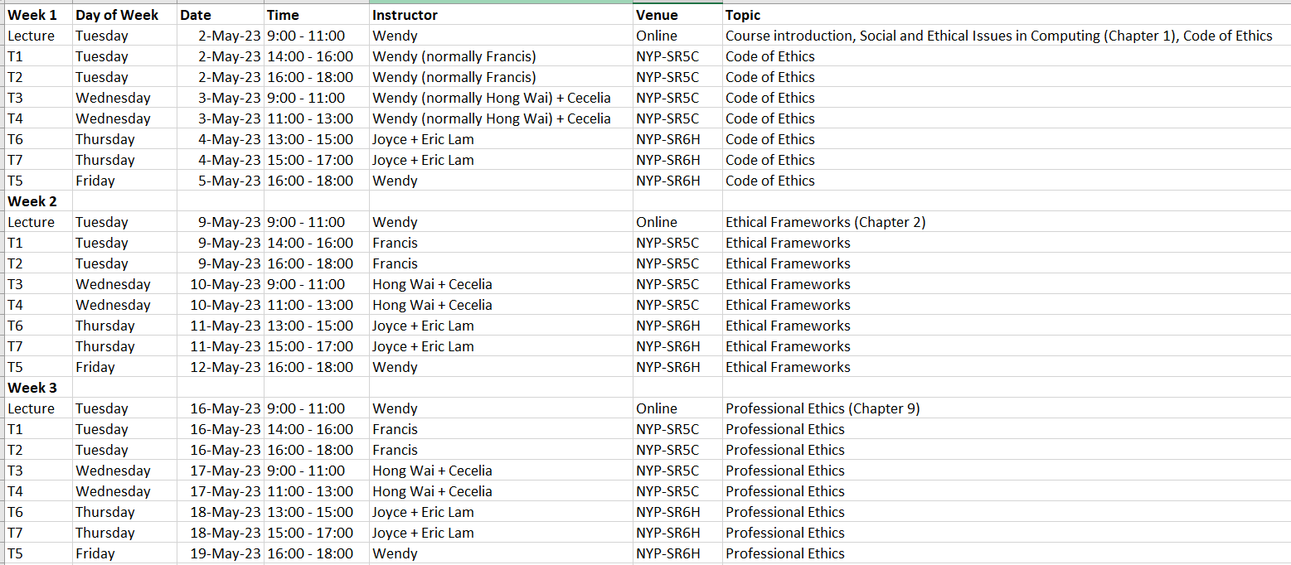
Lecture and Workshop Schedule

Slide 5
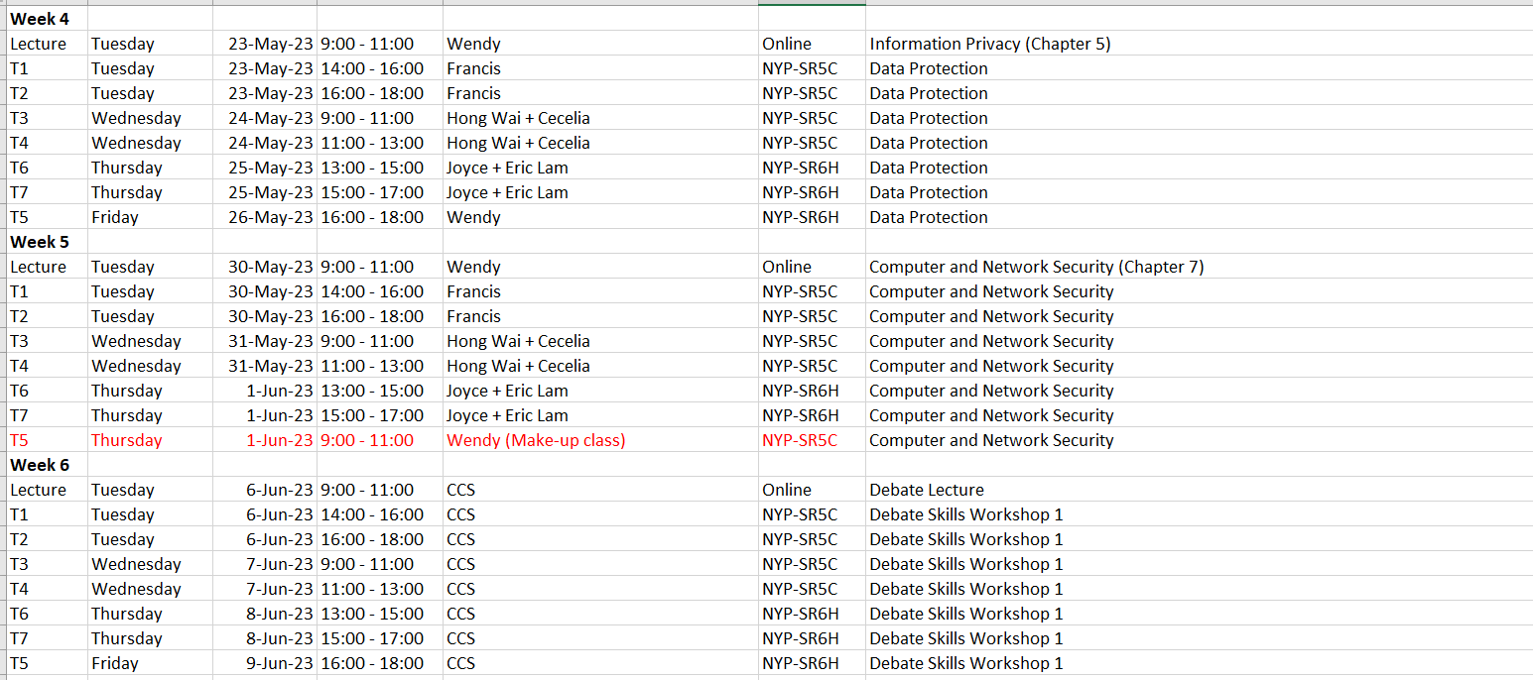
Lecture and Workshop Schedule (Cont’d)

Slide 6
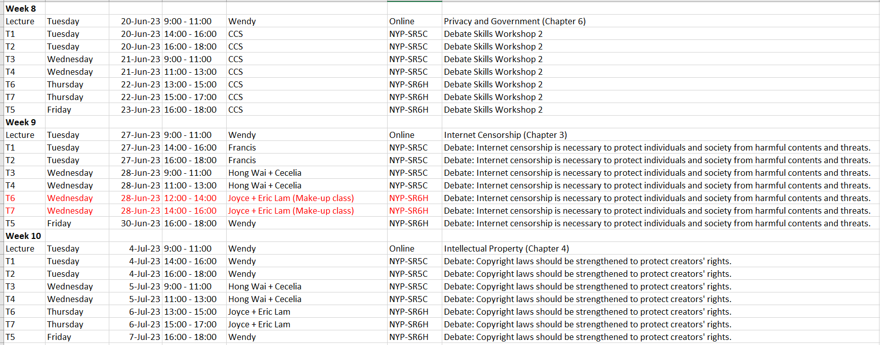
Lecture and Workshop Schedule (Cont’d)

Slide 7
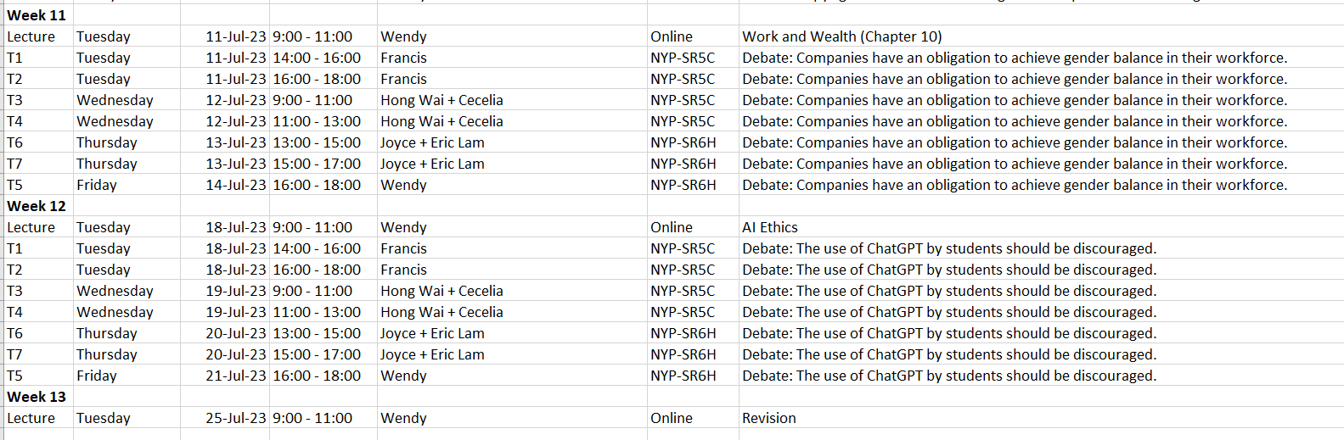
Lecture and Workshop Schedule (Cont’d)

Slide 8
Learning Outcomes
After successfully completing this module you should be able to:
Describe the contemporary ethical and professional issues in computing.
Apply different ethical theories in a work environment.
Demonstrate effective presentation of moral reasoning about ethical issues in the computing profession.
Understand how culture may shape the moral beliefs in a society and be able to work with people who may hold different views.
Understand your duties and responsibilities as a computing professional.

Slide 9
Assessments
Quizzes (Individual) (30%): Weekly quizzes to test your understanding of the lecture materials.
Debate (Group) (Total 35%)
Oral debate (15%)
Written report (20%)
Final Exam (Individual) (35%)
More information will be given near the end of the trimester
Peer review, attendance and class participation (0%): May be consulted
Peer review will be conducted at the end of the trimester. You will be asked to evaluate each team member’s contribution in survey.
Workshop attendance will be recorded
Class participation will be recorded by Classpoint / interactive quizzes within videos (please use your real name or student ID)

Slide 10
Quizzes
One quiz at the end of each lecture.
You will first be given 5 quiz questions and discuss them among your teammates for 5 minutes.
You will attempt the quiz on xSite. 7 questions will be randomly selected from a pool of 10 questions. In this pool of 10 questions, 5 are the questions you were given earlier. 5 are questions that you have not seen before. So, if you are lucky, you may get all the 5 questions you have already discussed with your team, plus 2 unseen questions. If you are less lucky, you may get only all the 5 unseen questions and only 2 of the previously discussed questions.
Most of these questions are quite simple. You should not extrapolate your quiz performance to estimate your final grade.

Slide 11
Groups
You have been randomly assigned to groups. Please check the new announcement on xSite.
Please enrol yourself to the assigned group on xSite.

Slide 12
Debate
Each team has been randomly assigned to do one of the following debate topics:
Debate Topic | Week
Internet censorship is necessary to protect individuals and society from harmful contents and threats. | Week 9
Copyright laws should be strengthened to protect creators' rights. | Week 10
Companies have an obligation to achieve gender balance in their workforce. | Week 11
The use of ChatGPT by students should be discouraged. | Week 12

Slide 13
Example of a debate
https://www.youtube.com/watch?v=TvG5hmuaYfs (First 18 mins)

Slide 14
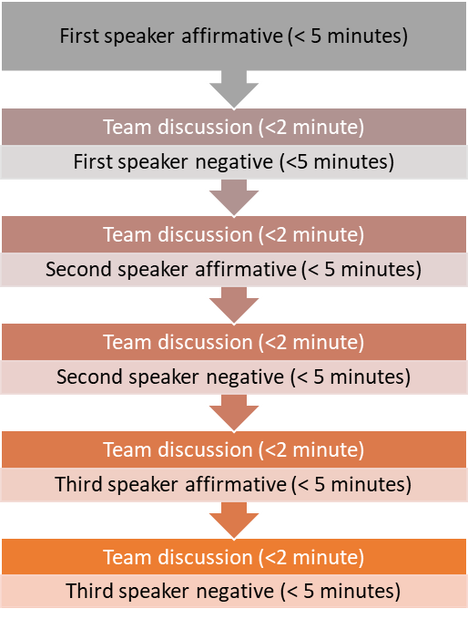
Our Debate Format (much less stressful)
Oral Debate (15%)
Q&A from the audience only, at the end of the debate.
The audience only votes for the winning team, instead of individual speakers.

Slide 15
Preparation for the Debate
At the beginning of the tutorial, the instructor will randomly assign your team to either the affirmative side (i.e., you agree with the topic) or the negative side (i.e., you disagree with the topic).
Therefore, before you come to the tutorial, you should prepare arguments from both sides.
You are required to show your preparation for the debate in the form of a written report and submit it onto xSite.

Slide 16
Ethics for the Information Age

Slide 17
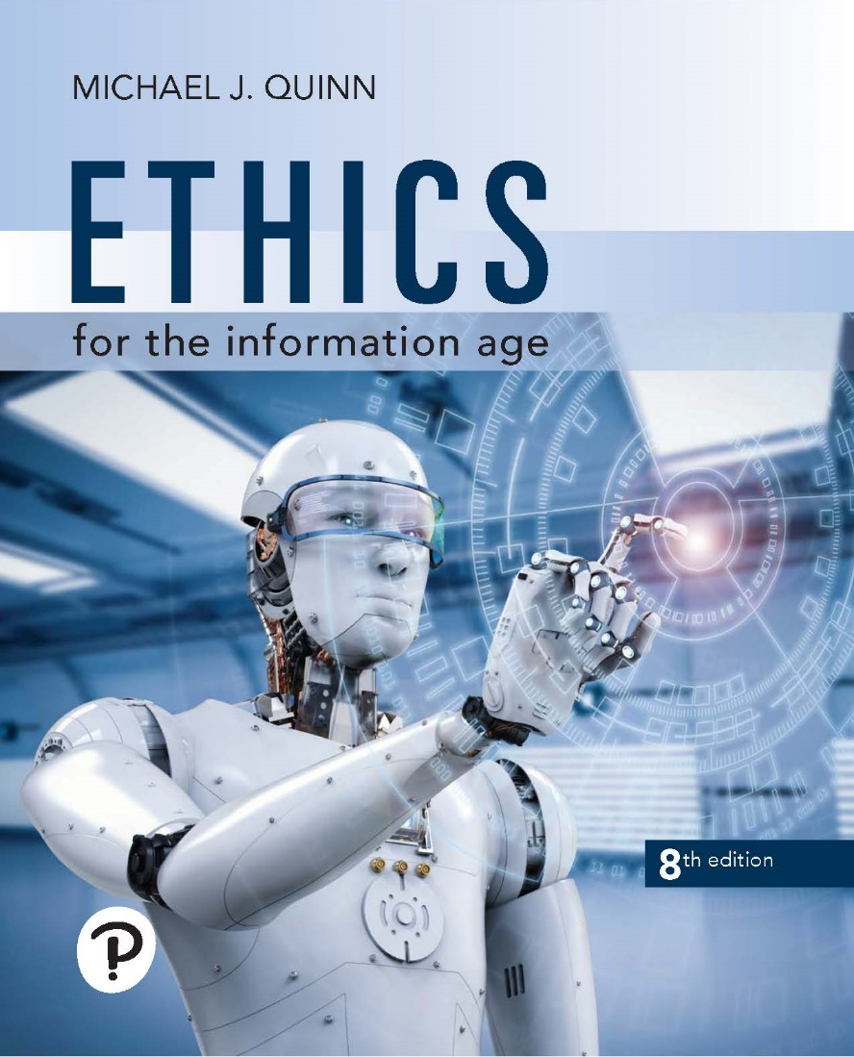
Ethics for the Information Age
Eighth Edition
You do not need to buy the book.
Chapter 1
Catalysts for Change

Slide 18

Information Age
Unprecedented access to information in modern era
Catalysts
Low-cost computers
High-speed communication networks
New technologies continue to emerge
Smartphones
Low-cost drones
Self-driving cars
Copyright © 2020, 2017, 2015 Pearson Education, Inc. All Rights Reserved

Slide 19
Our Relationship with Technology
Dynamic between people, technology
People create, adopt technology
Once adopted, technology changes society
Using technology can change people
Experiences cause physical changes in brains
E.g., getting information releases dopamine in brain, producing a desire to seek out additional information
Experiences with technology can have psychological effects, too (e.g., dependency on cell phones)
Copyright © 2020, 2017, 2015 Pearson Education, Inc. All Rights Reserved

Slide 20

Our Relationship with Technology (Cont’d)
Technologies solve problems, but may create new problems
Automobiles
Greater mobility
Traffic jams
Web
Supports valuable information retrieval tools
Children may be exposed to inappropriate contents
Low-cost international communication
Global access to news, entertainment
Jobs outsourced to less expensive labor markets
Mechanical calculators led to the “de-skilling” and “feminization” of bookkeeping. (Automatic Data Processing (A D P))
Copyright © 2020, 2017, 2015 Pearson Education, Inc. All Rights Reserved

Slide 21
Why Ethics?
Computing professionals should be thoughtful about their role in creating the future.
How should IT professionals ensure that IT is used to bring benefits and do no harm to users and the society?
IT professionals should also be prepared to make a decision when faced with an ethical dilemma.

Slide 22
Ethical Issues Related to IT
Privacy and data protection (Week 4)
Information security (Week 5)
Internet censorship (Week 9)
IP protection (Week 10)
Work and wealth (Week 11)
AI (Week 12)

Slide 23
Guidance from Rules, Ethical Principles, Ethical Frameworks
Rules and principles are sometimes used interchangeably by authors
In this lecture, rules are more specific than principles:
E.g., “No eating or drinking in the classroom.”
Very easy to apply
Applicable only to specific contexts
Principles are more general than rules, e.g., professional code of ethics (more on this in the following slides)
Ethical theories or frameworks are more general than principles (more on this next week)
Important in situations:
that have not been studied / encountered previously
where the rules / principles are not applicable

Slide 24
Code of Ethics

Slide 25

Definitions
Profession
“A profession is a vocation founded upon specialized educational training, the purpose of which is to supply disinterested objective counsel and service to others, for a direct and definite compensation…”

Slide 26
Definitions (Cont’d)
Professional
“A professional is a member of a profession or any person who works in a specified professional activity. The term also describes the standards of education and training that prepare members of the profession with the particular knowledge and skills necessary to perform their specific role within that profession. In addition, most professionals are subject to strict codes of conduct, enshrining rigorous ethical and moral obligations. Professional standards of practice and ethics for a particular field are typically agreed upon and maintained through widely recognized professional associations, such as the IEEE.”
…In some cultures, the term is used as shorthand to describe a particular social stratum of well-educated workers who enjoy considerable work autonomy and who are commonly engaged in creative and intellectually challenging work. (August 2021).

Slide 27
Codes of Ethics / Conduct
We will look at:
ACM Code of Ethics and Professional Conduct
Singapore Computer Society Code of Conduct
These codes of ethics / conduct provide guidance in:
Ethical decision making
Conduct work in a professional manner
Examples: “SCS members will always aim to increase their competence.”

Slide 28
SCS Code of Conduct
SCS members will:
act at all times with integrity
accept full responsibility for their work
always aim to increase their competence
act with professionalism to enhance the prestige of the profession and the Society

Slide 29
SCS Code of Conduct - Integrity
SCS members will act at all times with integrity. They will:
not lay claim to a level of competence that they do not possess
act with complete discretion when entrusted with confidential information
be impartial when giving advice and will disclose any relevant personal interests
give credit for work done by others where credit is due

Slide 30
SCS Code of Conduct – Full Responsibility
SCS members will accept full responsibility for their work. They will:
carry out their assignments in a professional manner
adhere to their employers' or client's standards and guidelines
indicate to their employers or clients the consequences to be expected if their professional judgement is overruled

Slide 31
SCS Code of Conduct - Competence
SCS members will always aim to increase their competence. They will:
continue to upgrade their knowledge and skills, and be aware of relevant development in the technology they are involved in
provide opportunity and encouragement for professional development and advancement to fellow professionals and aspirants to the profession
extend public knowledge, understanding and appreciation of information technology and to oppose false or deceptive statements related to information technology of which they are aware

Slide 32
SCS Code of Conduct - Professionalism
SCS members will act with professionalism to enhance the prestige of the profession and the Society. They will:
uphold and improve the professional standards of the Society through participation in their formulation, establishment and enforcement
not seek personal advantage to the detriment of the Society
not speak on behalf of the Society without proper authority
not slander the professional reputation of any other person
use their special knowledge and skill for the advancement of human welfare

Slide 33
ACM Code of Ethics and Professional Conduct
1. General Ethical Principles:
1.1 Contribute to society and to human well-being, acknowledging that all people are stakeholders in computing.
1.2 Avoid harm.
1.3 Be honest and trustworthy.
1.4 Be fair and take action not to discriminate.
1.5 Respect the work required to produce new ideas, inventions, creative works, and computing artifacts.
1.6 Respect privacy.
1.7 Honor confidentiality.

Slide 34
2. Professional Responsibilities
2.1 Strive to achieve high quality in both the processes and products of professional work.
2.2 Maintain high standards of professional competence, conduct, and ethical practice.
2.3 Know and respect existing rules pertaining to professional work.
2.4 Accept and provide appropriate professional review.
2.5 Give comprehensive and thorough evaluations of computer systems and their impacts, including analysis of possible risks.
2.6 Perform work only in areas of competence.
2.7 Foster public awareness and understanding of computing, related technologies, and their consequences.
2.8 Access computing and communication resources only when authorized or when compelled by the public good.
2.9 Design and implement systems that are robustly and usably secure.

Slide 35
3. Professional Leadership Principles
3.1 Ensure that the public good is the central concern during all professional computing work.
3.2 Articulate, encourage acceptance of, and evaluate fulfillment of social responsibilities by members of the organization or group.
3.3 Manage personnel and resources to enhance the quality of working life.
3.4 Articulate, apply, and support policies and processes that reflect the principles of the Code.
3.5 Create opportunities for members of the organization or group to grow as professionals.
3.6 Use care when modifying or retiring systems.
3.7 Recognize and take special care of systems that become integrated into the infrastructure of society.

Slide 36
4. Compliance with the Code
4.1 Uphold, promote, and respect the principles of the Code.
4.2 Treat violations of the Code as inconsistent with membership in the ACM.

Slide 37
The IT Professional
“A profession is a calling that requires specialized knowledge and often long and intensive academic preparation” (Reynolds 2012)
In the context of this module, an IT Professional is an employee who can:
Apply knowledge and understanding of information issues to solve problems and complete tasks
Communicate and negotiate effectively
Demonstrate a commitment to ethical professional behaviour

Slide 38
IT Professional Skills
Interpersonal communication and teamwork
Internal and external
Formats and settings
Client/customer service
Problem solving and initiative/leadership
Continuous learning
Information management and technology skills
Business and project management
Commitment to ethical conduct
Acting with Honesty, Integrity, Fairness
Ensuring CIA
Adhering to professional codes of conduct

Slide 39
Preparing for the first Tutorial
Please go through the following before coming to the tutorial:
ACM Code of Ethics and Professional Conduct
Singapore Computer Society Code of Conduct

